Slide 1
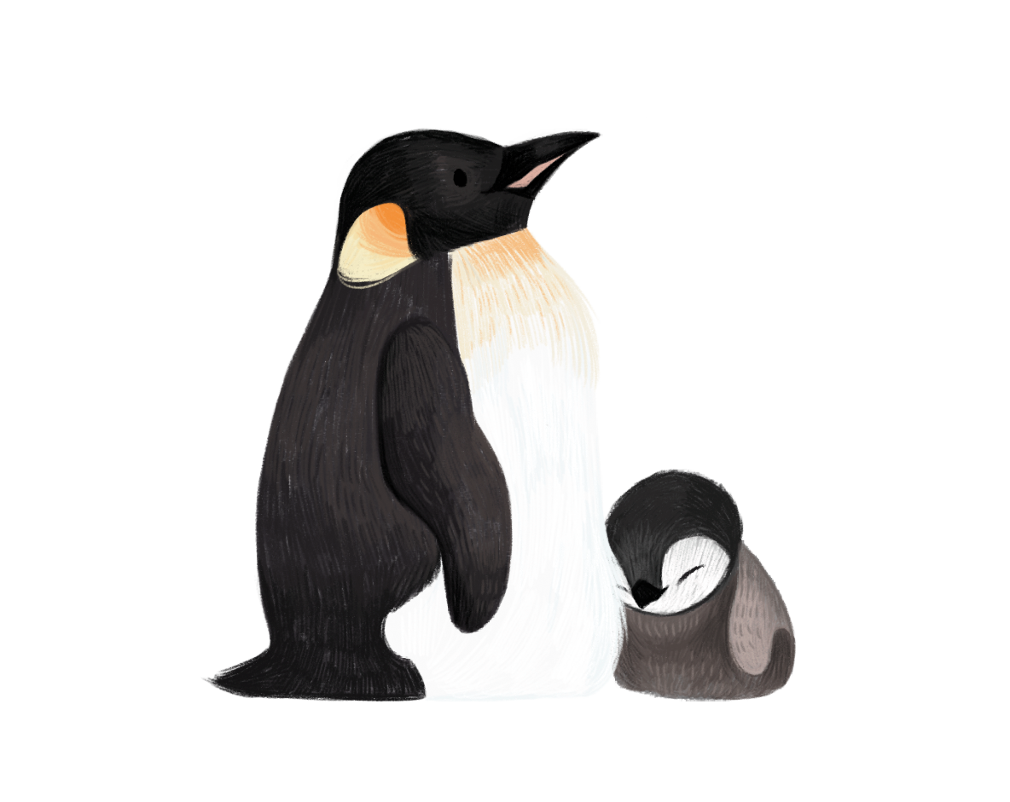
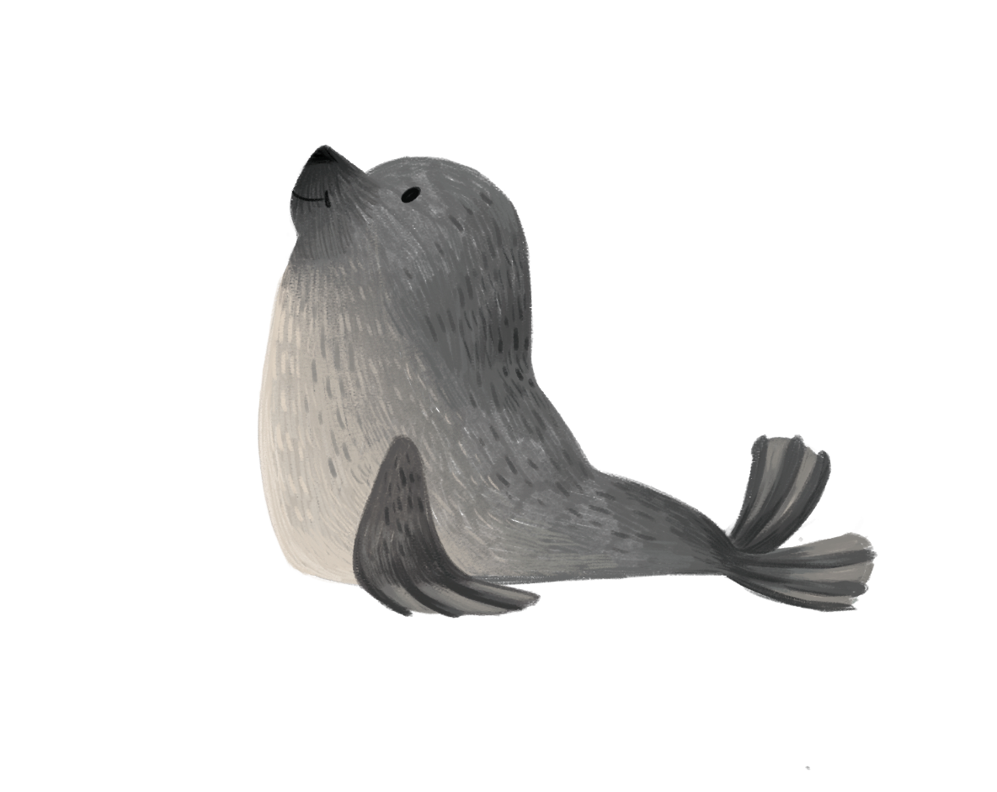
The Association of Polar Early Career Scientists
Since 2007 in Belgium
Valentina Savaglia
22.09.2022
BNCAR symposium – Brussels - Belgium

Slide 2
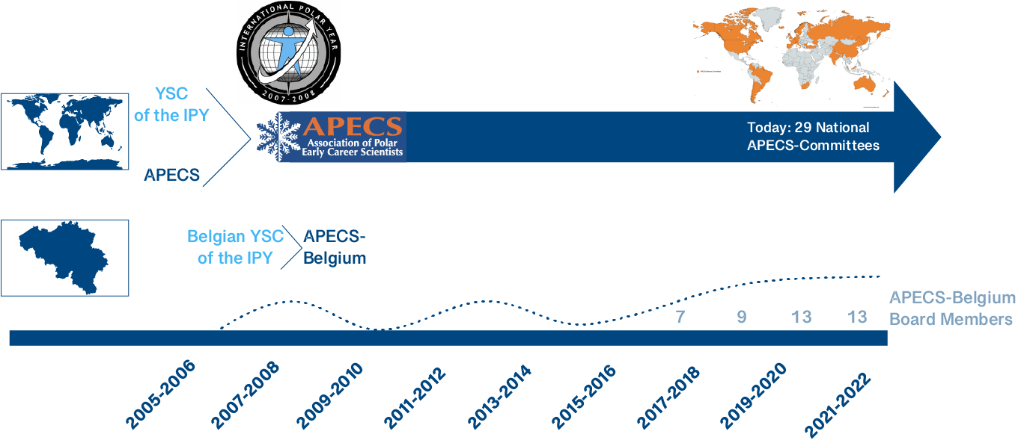
A bit of history

Slide 3
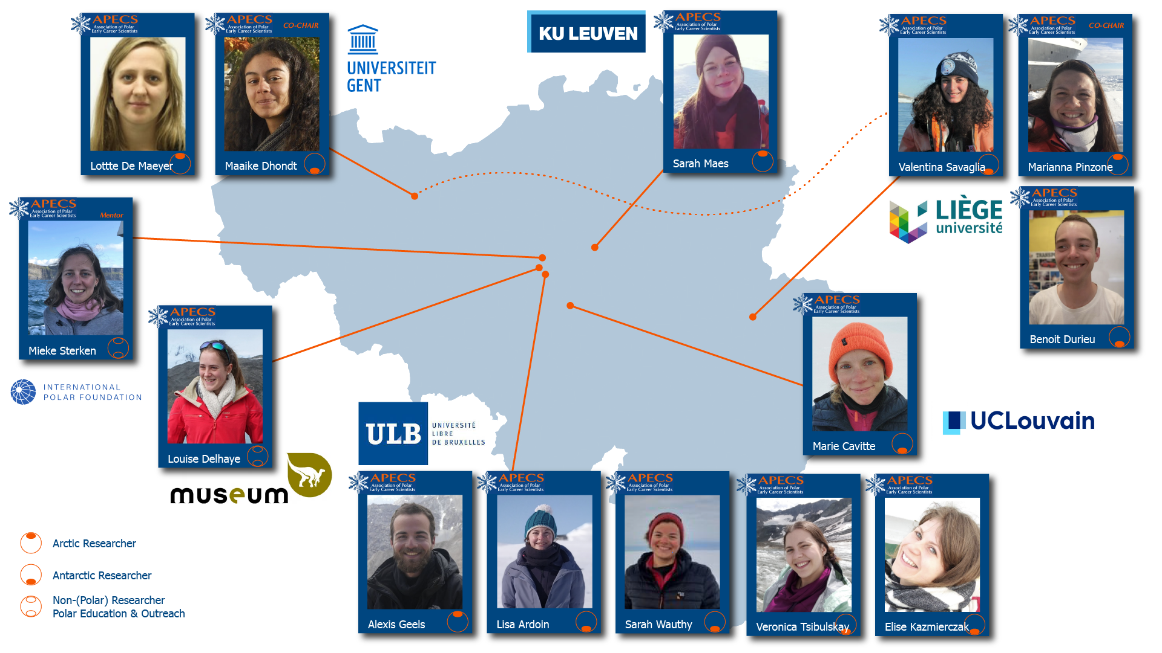
Who are we?

Slide 4
Main axes
1.
OUTREACH
Organisation of activities open to everyone
2.
Social media
3.
EDUCATION
Activities with schools and organisation of workshops
Photo exhibitions
Polar weeks
Art projects
Job alert
Blog
Q&A
Symposiums
Workshops
School visits
COMMUNICATION

Slide 5
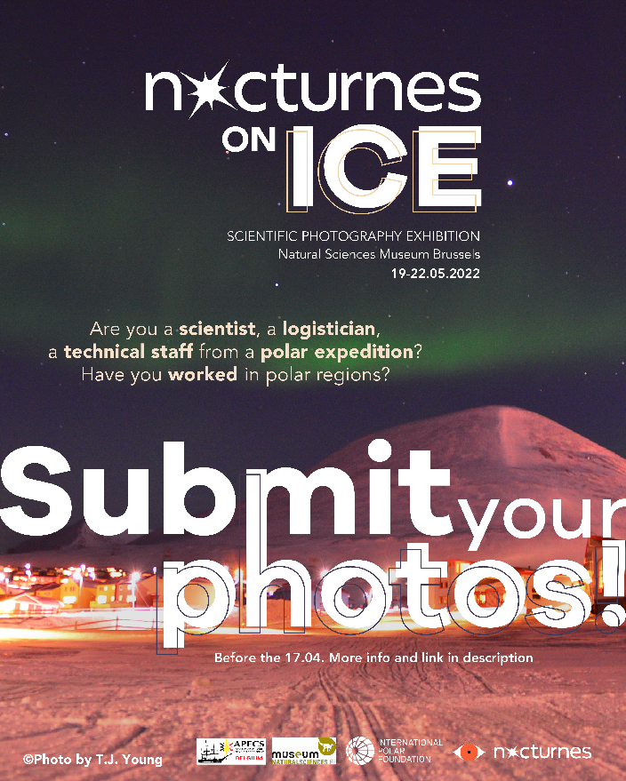
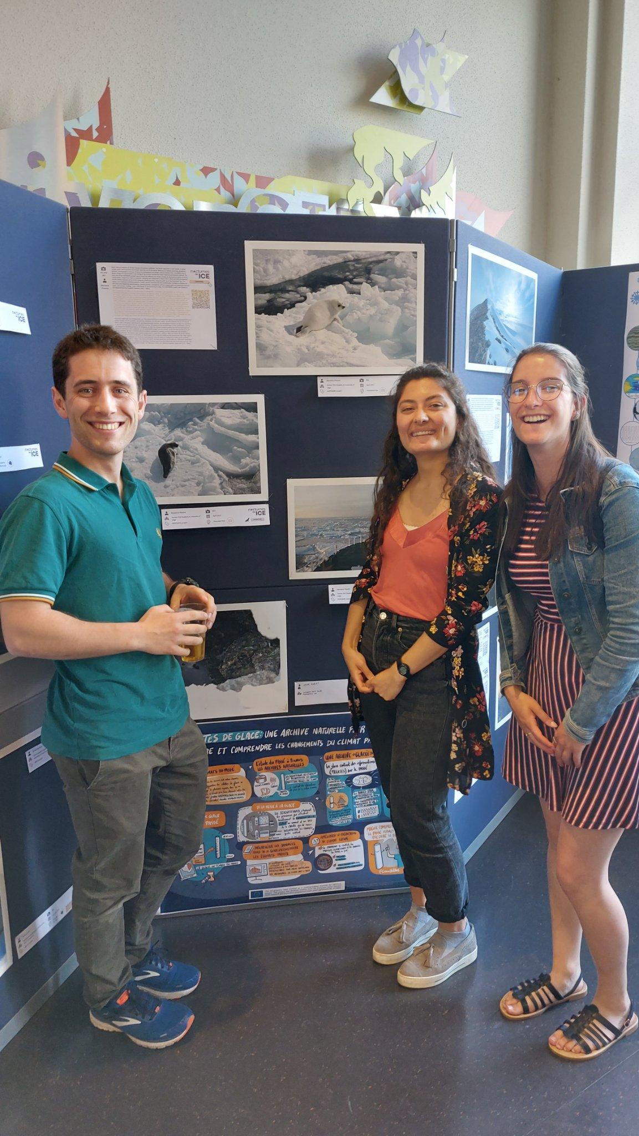
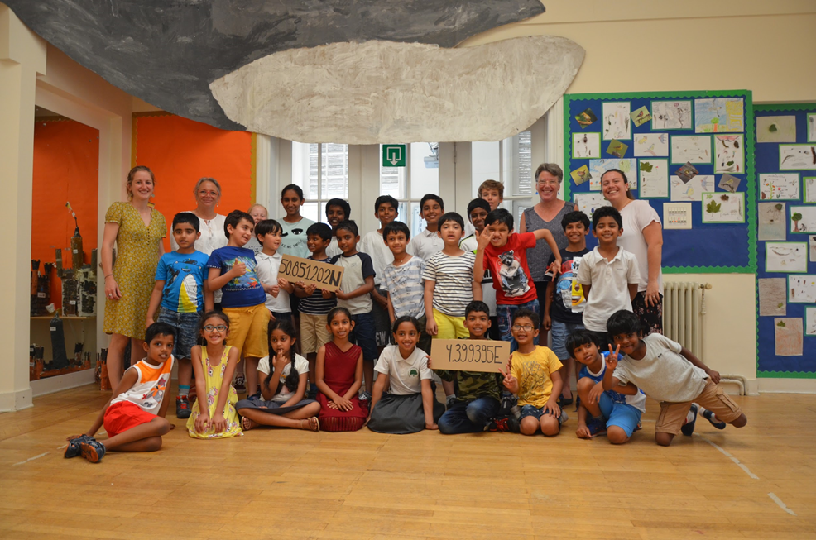
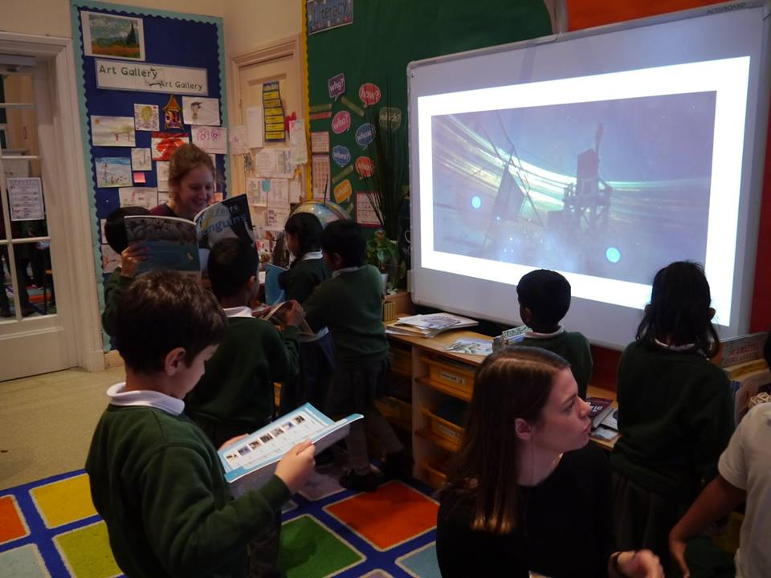
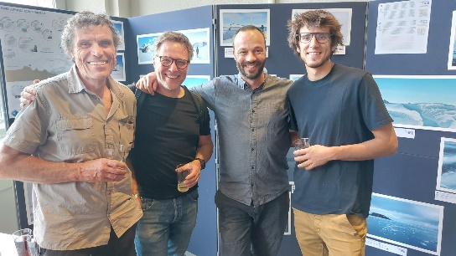
We are active!
book publication with stories written by children from every corner of Belgium inspired from pictures of Antarctica,
founded by BelSPO
photo exhibition together with IPF at the Museum of Natural Sciences in Bruxelles
school visits

Slide 6
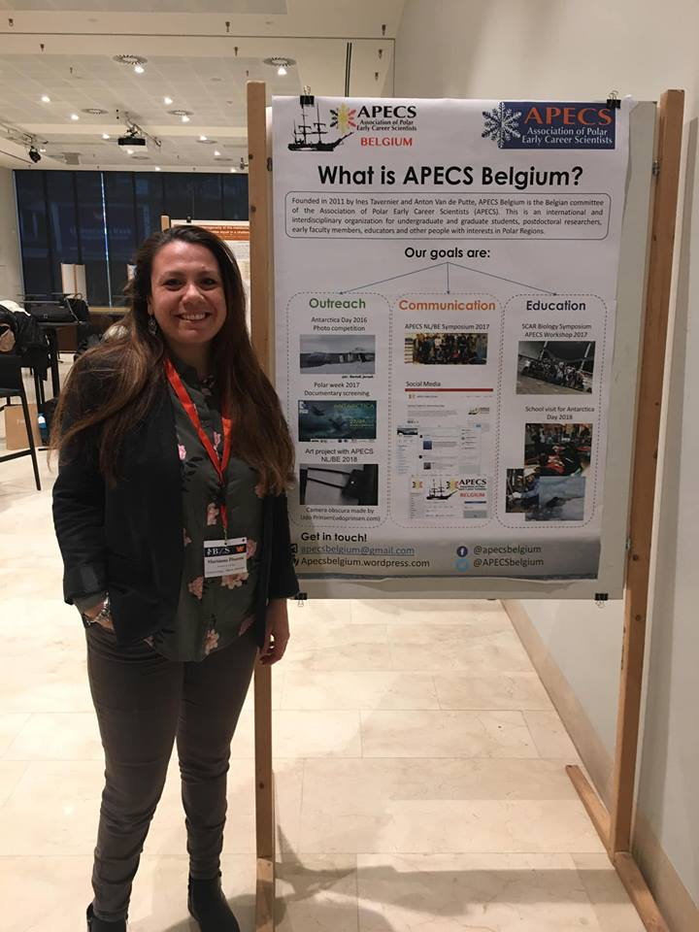
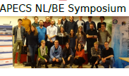
We are active!
movie screening open to everyone
poster presentation to the NL Polar Symposium
advertising open positions in Belgium
map with laboratories working
on polar-related projects
APECS NL/BE workshop 2017

Slide 7
APECS: an opportunity for
early career scientists
Scientific article publications
IPCC revisions
EPB plenary meetings rapporteurs
Communication skills (oral presentations, blog post writing)
Community-building → support
Education skills (raise awareness about climate change and other sensitive topics)
Networking (nationally & internationally)

Slide 8
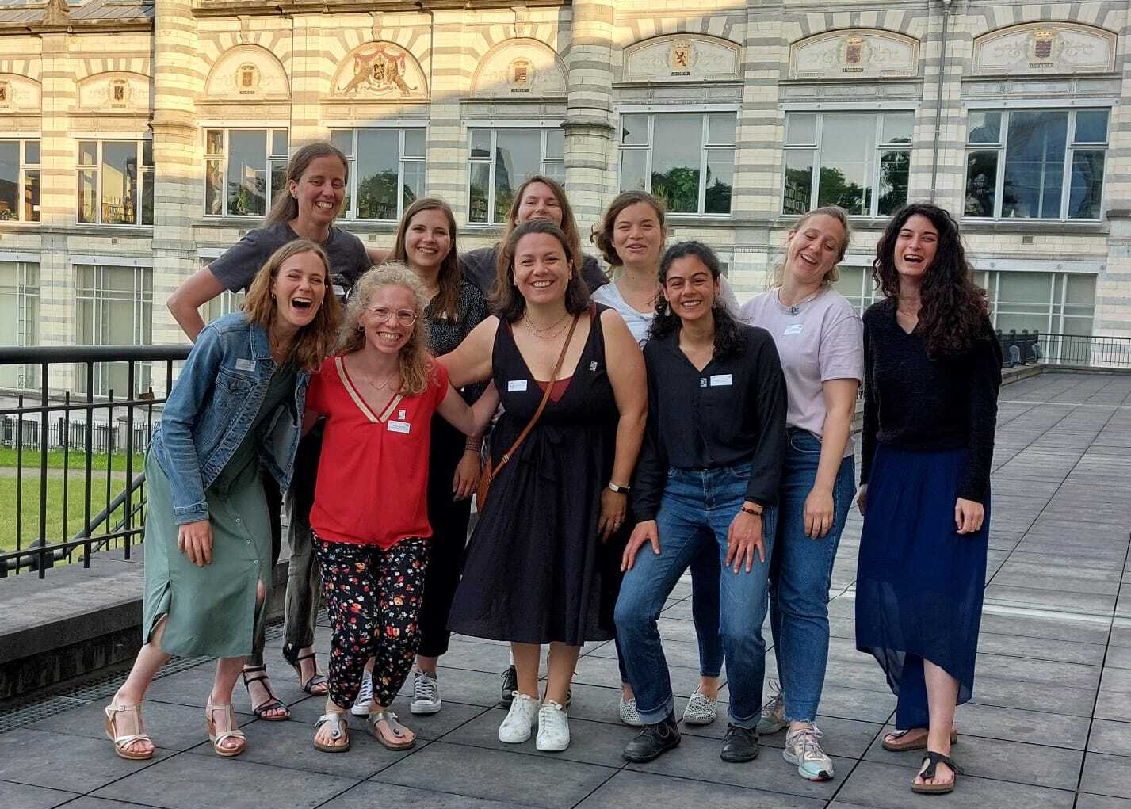
Thank you!
Apecs belgium
@APECSbelgium
@apecsbelgium
apecsbelgium.wordpress.com
@
apecsbeglium@gmail.com
Support our activities!
IBAN: BE06735044962922
Name: APECS Belgium
Bank: KBC

