Slide 1
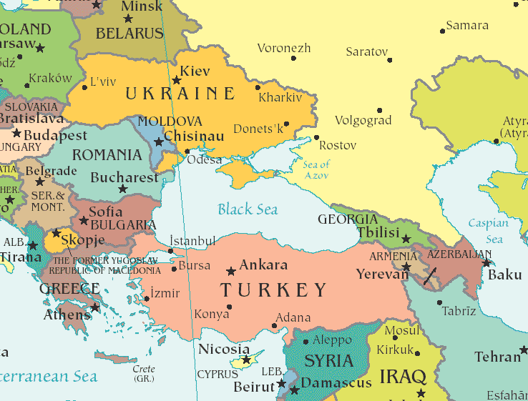
The Black Sea Economic Cooperation (BSEC):
20 years after
Presentation by H.E Mr Ştefan Tinca, Ambassador of Romania to the
Kingdom of Belgium
Brussels, 15 April 2013

Slide 2
A historic view of the
Black Sea region
* successive hegemony
* limited Western-style governance, ideas or values
* COLD WAR: non history; POST-COLD WAR: much more dynamism and a mix of trends:
- regional “harmony” at the beginning, aiming at a conflict-free area and conducive to genuine regional cooperation.
- quest for markets and economic influence: Turkey and Greece - the main economic and financial centres around the sea
- “emancipation wave”: EU/NATO accession of Romania and Bulgaria, GUAM states (Georgia, Ukraine, Azerbaijan and Republic of Moldova)
- status quo trend
* Instead of the end of history, the region witnessed the reinvention of geopolitics

Slide 3
source:www.grida.no

Slide 4
source: www.grida.no

Slide 5
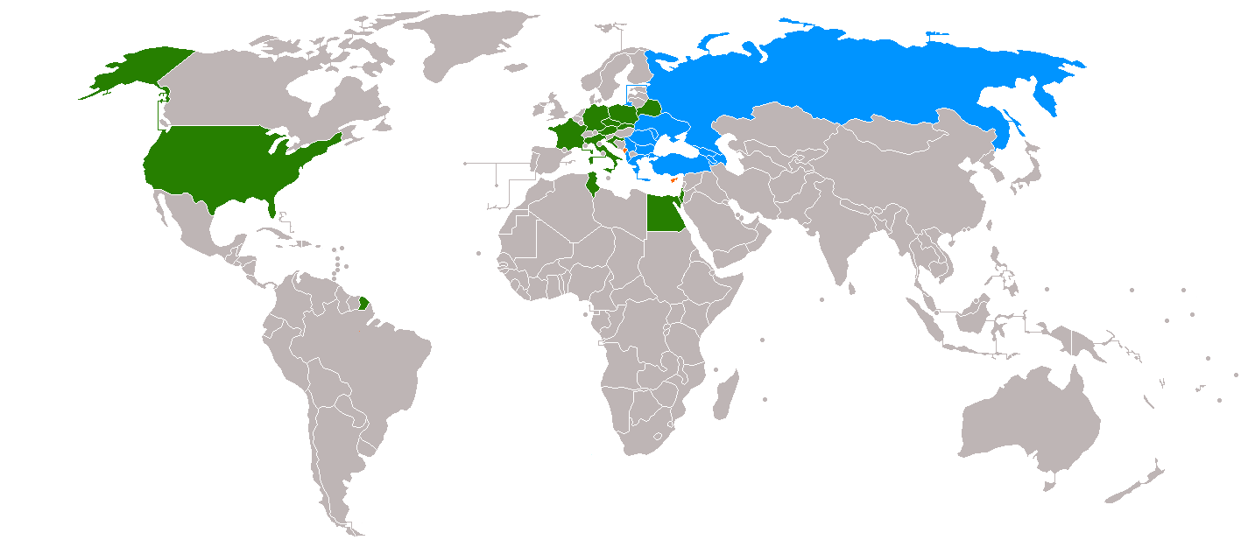
BSEC Map
Members of BSEC
Observers to BSEC

Slide 6
Presentation of BSEC
25 June 1992, eleven countries: Albania, Armenia, Azerbaijan, Bulgaria, Georgia, Greece, R. Moldova, Romania, Russia, Turkey and Ukraine signed the Istanbul Summit Declaration and the Bosphorus Statement giving birth to the Black Sea Economic Cooperation (BSEC).
BSEC came into existence as a unique and promising model of multilateral political and economic initiative aimed at fostering interaction and harmony among the Member States, as well as at ensuring peace, stability and prosperity and encouraging friendly and good-neighborly relations in the Black Sea region.
Three distinctive stages in BSEC existence: until 1999, 1999-2007, after 2007

Slide 7
Main evolutions in the region
A Strategic shift
1992-1999:
new states, searching new identities and international and regional profiles
de-sovietisation, de-comunisation
frozen conflicts
but BSEC shows the positive outcome: the need for a formal organisation, based in Istanbul (1999)
2007-present
Growing divisions among Member States
Global economic crisis
Impact on BSEC becomes significant
1999-2007
Progressive advancement of EU and NATO towards Eastern Europe
Enlargement of NATO (2004) and EU (2007)
BSEC becomes gradually a fully-fledged regional organisation, with complete
institutional architecture. BSEC Charter: 1 May 1999

Slide 8
Security perspective
Security landscape dominated by:
inherited elements: situation of Russian armed forces and the frozen conflicts
new elements: NATO’s enlargement, growing assertiveness of Russian foreign policy , evolving regional role of Turkey
Overall security situation marked by the strategic shift that occurred after 2004 (NATO enlargement)
BSEC has no role in hard security, only limited role in soft security matters. Regional cooperation in military field is provided in other formats (BLACKSEAFOR, BLACK SEA HARMONY)

Slide 9
Economic perspective
Roller coaster type of economic evolution in the BSEC area
BSEC Economic Agenda: economic projects and economic cooperation, focusing notably on infrastructure, energy, trade and investment, but others as well.
but most of the countries see their source of development
outside the BSEC area; intra-BSEC trade and investment is still
at rather low levels, both in volume and in percentage of total
national trade and investment.
Economic transition in the 90s
the economic boom with its peak in 2008, fuelled by the housing bubble, heavy speculation and lack of reforms
the effects of the global crisis reached the Black Sea region after 2009 and translated into severe economic recession for most of BSEC members

Slide 10
Energy security perspective
But also new trends: shale gas, the renewables (green energy a promising future in the region), changing world market
Energy: on top of BSEC’s and the international agenda
European Energy Strategy (2010) and the concept of the Southern Corridor reaffirms the strategic importance of the Black Sea
Main projects proposed so far by EU and Russia in the Black Sea Region:
Nabucco
Blue Stream
South Stream
Other alternatives (IGTI, White Stream, AGRI)

Slide 11
Perspective on society
Two factors fundamentally inhibited regional cooperation in the Black Sea area:
  lack of a single space of movement for citizens in the region in the context of a realignment of borders and migration policies of countries in the region after EU enlargement
  lack of a regional identity, affecting the quality of human and cultural contacts
Logically, these are the areas in which BSEC has the highest potential
BSEC has implemented cooperation projects in areas such as culture, education, public health and tourism
BSEC has kept a low profile in areas such as supporting civil society, human rights and promotion of democracy
Less successful on networking of civil society or local authorities

Slide 12
Presentation of BSEC
Decision making
Secretariat
(PERMIS)

Slide 13
Presentation of BSEC
Political priorities
Main priorities of each CiO can be split into 3 categories:
Thematic issues: environment, green economy (Greek Presidency), transport, energy, IT and research, civil emergency, organized crime, agriculture
Institutional reform of BSEC: adoption of the fast-track mechanism (2007) paved the way for the BSEC PERMIS. After 2008, very limited discussions on institutional reform (Last attempt: Romanian CiO (2011) in Sinaia - the culture of dialogue.
Relations with other external partners: EU-BSEC interaction; UN and UN frameworks, other regional formats

Slide 14
Presentation of BSEC
Working methods
Committee of Senior Officials (CSO) is made of high-ranking officials from the MFAs of member states
Main task of CSO is to coordinate activities of the 19 thematic working groups (WG) of BSEC dealing with a large range of activities
The 19 WGs are chaired by different member states or by PERMIS with a mandate of 2 years with possible extension.
The WGs play a central role in implementing resolutions adopted by ministers and the sectorial Action Plans.

Slide 15
Presentation of BSEC
The Secretariat of BSEC (PERMIS)
Activity of the Permanent Secretariat is determined by three basic factors:
Mandate: Ensuring that the overall activity of BSEC id carried on swiftly. Main tasks are to organize meetings, prepare paper work, report and manage the budget.
Human resources: PERMIS staff is appointed by member states with majority voting based on the principle of rotation.
Budget: BSEC has its own regular budget of around 1.5 million euro (mandatory). Project Development Fund (PDF) for financing economic projects with a regional dimension (voluntary, mainly EL and TR).

Slide 16
Presentation of BSEC
Associated bodies and financing
Parliamentary Assembly (PABSEC) – representatives of national parliaments
International Center for Black Sea Studies (ICBSS), based in Athens – BSEC’s think tank. It delivers opinions, makes recommendations, initiates debates
Black Sea Trade and Development Bank (BSTDB), based in Thessaloniki. It acts like an IFI, but affiliated to BSEC. Current portfolio of around €1.5 bln.
Other financial instruments: PDF (managed by BSEC, but not part of BSEC budget); HDF (Greek fund for BS projects)

Slide 17
Presentation of BSEC
Flagship projects
1. The Black Sea Ring Highway (BSRH)
strategic objective: upgrade the road infrastructure around the Black Sea and become an integral part of the European Transport Network
problematic issues:
1. the European Commission reluctant to include BSRH among its own projects under the TEN-T program;
2. one segment involves the crossing of the breakaway province of Abkhazia, the difficult relations between Georgia and Russia;
3. the connection between south-western Ukraine and Istanbul.
Overall agreement to work with alternative trajectories where this is problematic. Current discussions on common standards and requirements.

Slide 18
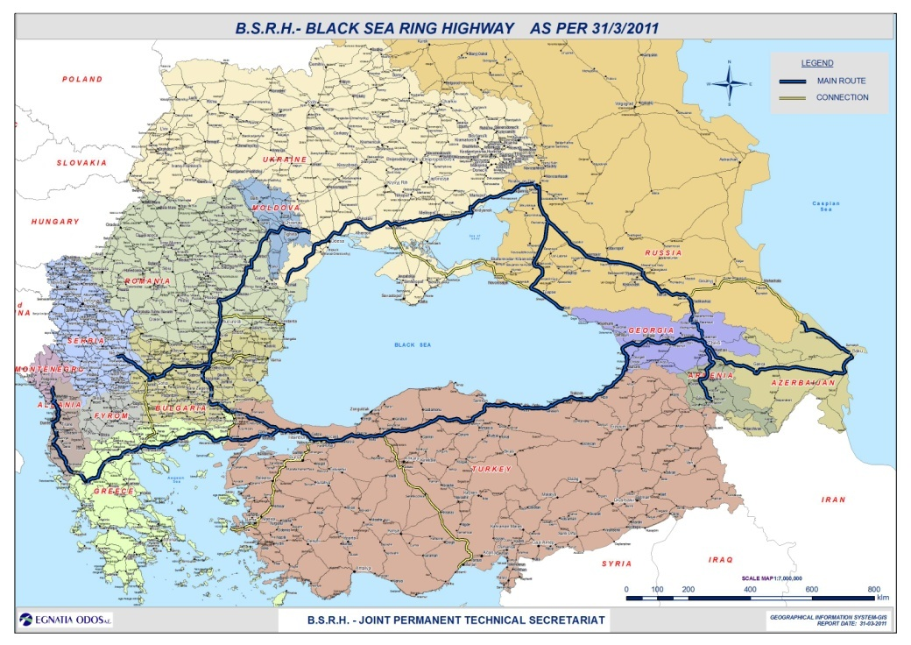
Source: The Joint Permanent Secretariat for the Black Sea Ring Highway

Slide 19
Presentation of BSEC
Flagship projects
2. The Black Sea Motorways of the Sea (BSMoS)
strategic objective: promote cooperation among port authorities and business authorities from BSEC member states; exchange of best practices between Black Sea ports and other ports from the EU
problematic issues: as with BSRH, the European Commission is concerned with the economic soundness of the project and its potential overlap with other existing EC projects
Recent agreement to set up the Secretariat in Turkey for the initial period of 3 years, followed up probably by Constanta (RO).

Slide 20
Assessment of BSEC functioning and results
Flagship projects
3. The BSEC Permit for lorry drivers
Project launched in February 2010. Its goal is to allow trucks of participating states to transit through other participating states with one document instead of several ones.
4. Emergency assistance
The WG on Cooperation in Emergency Assistance is one of the most active within BSEC. Agreement on Collaboration in Emergency Assistance and Emergency Response to Natural and Man-made Disasters + Additional Protocol. BSEC Network of Liaison Officers since 2009
5. Science and technology
BSEC an international partner of EU within the 7th Framework Programme (FP7). Most successful in creating regional networks of scientists.
6. Green Energy
Original project proposed so far by the Energy WG was the establishment of an integrated Black Sea energy market. Problematic issues: divergent energy interests, especially on energy infrastructure projects and energy mix.
Today: green energy a major avenue in the New Economic Agenda.

Slide 21
Assessment of BSEC functioning and results
International relationships
UN General Assembly: observer status in the UN General Assembly since 8 October 1999. Since 2006, a UNGA resolution is adopted every two years on the cooperation between UN and BSEC
UNDP: Ongoing partnership between BSEC and UNDP under the Black Sea Trade and Investment Promotion Programme (BSTIP) since December 2006
Central European Initiative (CEI): A MoU on cooperation signed between the BSEC and CEI on 7 March 2011
European Union: the European Commission was granted observer status to BSEC in 2007 and a regular dialogue EU-BSEC was set up at senior officials’ level
Launch of the EU Black Sea Synergy Initiative on 14 February 2008.

Slide 22
An assessment of BSEC functioning and results
Positive side
BSEC is the only format of dialogue for all the states in the region
Good, Western-style institutional architecture
Gained its place in the international community as a regional cooperation actor
Good knowledge of the region, good networks for cooperation
Growing need for regional cooperation in Europe
Negative side
Decline of commitment and political support from its members
Project management
Severe impact of economic crisis on BSEC normal activity
BSEC depends on financing from outside. Poor attractiveness
Little sign to reverse the trend of diminishing support for BSEC.

Slide 23
Main actors in the Black Sea region:
Russia and Turkey
Russia:
main strategic goal in the Black Sea area is to remain powerful and decisive in the region
ready to use a wide range of instruments from hard power to soft power
regional cooperation is of little value. Its value consists in its capability to prevent initiatives outside the organization to take shape
interested in preserving its former influence in the region. A functioning, but a weak BSEC serves best this purpose.
Turkey
regional cooperation in the Black Sea region appears to have lost its initial importance
is for status quo in the area
aimed at keeping BSEC a predominantly economic entity
BSEC is still important as long as it ensures the leadership over this organization
ambivalent about the question of Western influence in the Black Sea region

Slide 24
Main actors in the Black Sea Region:
EU and US
EU:
Part of the region since 2007, but not keen to get involved.
Little knowledge about the region
Bilateral relations above regional cooperation
Seeks new strategic approaches to deal with Russia and Turkey
Remains highly attractive for its soft power
Black Sea or BSEC not a priority after Eastern Partnership
US
Supportive towards regional cooperation as long it serves its fundamental goals in the Black Sea region: security, democracy and HR, energy.
Close eye on BSEC, but sees it of little strategic importance. Works either on its own or together with EU on EaP.
Diminished interest on BSEC as it focuses on Pacific

Slide 25
Assessment of Black Sea regional cooperation
Three theoretical approaches
Minimalist approach
Regional cooperation in this region has objective limitations and BSEC cannot play a substantial role
Institutional approach
Regional cooperation is insufficiently harnessed and should be based on sound institutions like BSEC
Incremental approach
Regional cooperation is a process-oriented approach, in which institutions such as BSEC do play a role, but only together with states and societies
Approaches of Member States:
Russia, Georgia, Azerbaijan, Armenia see BSEC as a framework where national concerns prevail. No positive agenda for BSEC. Often at the origin of institutional blockage (e.g. the successive failed ministerial communiques)
Turkey and Greece support project-oriented BSEC and provide most of the funds, but reluctant to major institutional review.
Romania and Bulgaria, partially Ukraine and R. Moldova supportive towards regional cooperation, but no longer perceive BSEC as the main engine for regional cooperation, which can be achieved through other means.

Slide 26
Enhancing Black Sea Cooperation:
Possible ways forward
A significant change in the culture of the organization is needed:
A new culture of dialogue
veto gradually minimized or abolished
decisions taken by majority facilitate cooperation and dialogue
a more representative (influential) Secretary General and more effective PERMIS
A new culture of entrepreneurship
streamlining priorities in the New Economic Agenda
energy security and renewable energy to become headline goals
fresh look at the regional development of existing or planned Trans- European Networks
different approach of areas like environment, education and innovation
A new culture of partnership
need of streamlining and prioritization of existing partnerships
new kind of partnership with regional organizations such as CBSS, CEI, SEECP
a fruitful and meaningful partnership with the EU

Slide 27
Enhancing Black Sea Cooperation:
Possible ways forward
Harnessing the nature of the Black Sea as a sea of transit or a sea of connection.
Eastern focus: Baltic Sea - Black Sea - Caspian Sea. Through BSEC-CBSS partnership or rather an EU-led project through EaP.
Central European focus: Baltic Sea - Black Sea - Adriatic Sea. The Central European Initiative (CEI) long-term strategy focuses on creating a synergetic space spanning from the Baltic Sea towards the Black Sea and the Adriatic Sea and finding common ground in areas like economy, trade, education, culture and others. Hence, CEI-BSEC partnership or rather an EU-led project centered on the Danube strategy
Southern/SE focus: Mediterranean/Adriatic Sea - Black Sea - Caspian Sea makes some sense in the field of energy security and transport. Projects like BTC or BTE already a reality between the three seas. Of the three is appears to be the least political and most business oriented.
Value of regional cooperation in international relations

Slide 28
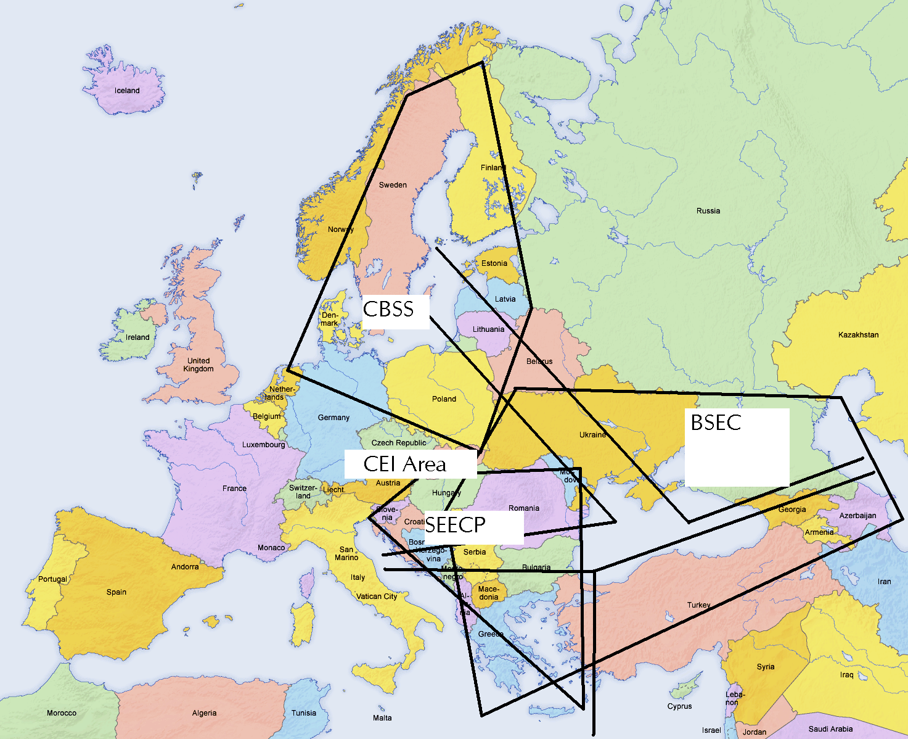
The figure below illustrates the potential for inter-linkages involving the Black Sea area

Slide 29
THANK YOU!
Q&A?

