Slide 1
Europe’s low carbon competitiveness after COP21
Jonathan Gaventa, E3G
4 May 2016

Slide 2
Threat
Opportunity
Action

Slide 3
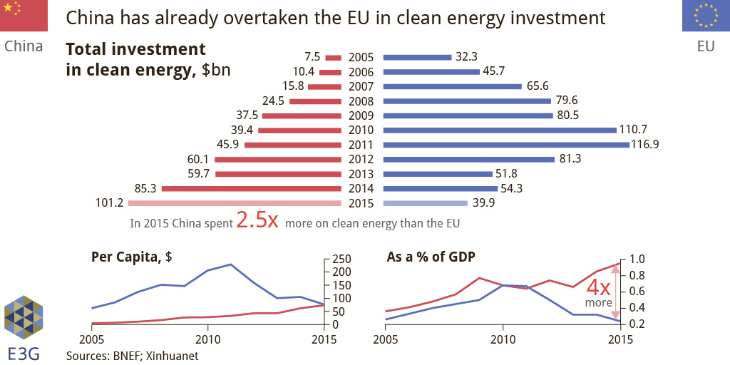
Complacency is dangerous

Slide 4
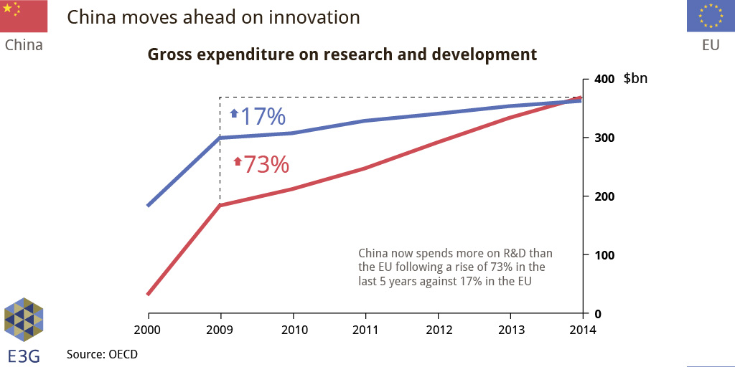
China has overtaken EU on R&D expenditure

Slide 5
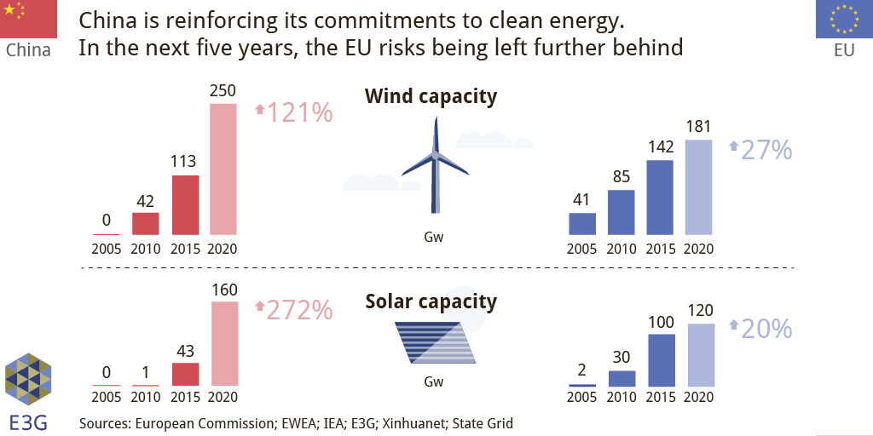
Domestic deployment is used to gain share in international markets

Slide 6
Threat
Opportunity
Action

Slide 7
Now-2025: Four key technologies represent >$600bn revenue opportunity
Solar PV
Onshore wind
LEDs
Electric vehicles
3- year CAGR 32%
3- year CAGR 36%
3-year CAGR 73%
3-year CAGR 10%
Paris ‘INDC’ commitments point to largest transformation in power sector and efficiency
Source: GS Sustain

Slide 8
Economic opportunities go beyond direct manufacture
Supply chains
Solar PV
Onshore wind
LEDs
Electric vehicles
Balance of systems
Technology, design and intellectual property
Installation, operation and maintenance

Slide 9
Economic opportunities go beyond direct manufacture
New consumer offers and business models
Smart infrastructure
Solar PV
Onshore wind
LEDs
Electric vehicles
Systems integration and system balancing
New consumer offers and business models

Slide 10
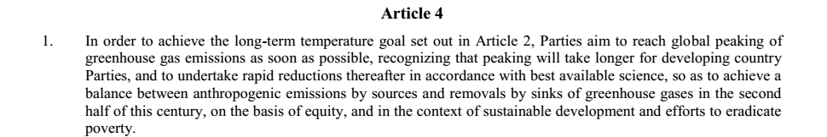
Longer-term: ‘net zero’ goal means innovation opportunities in all sectors of the economy

Slide 11
Threat
Opportunity
Action

Slide 12
Ecosystems, not miracles, needed for clean energy innovation
Construction, Infrastructure, Smart Grids, Demand Response, Smart Transport,
Government
Materials, Marine RES, Biotech
Policy Interventions
Basic R&D
Applied R&D
Demon-stration
Commercial
-isation
Diffusion
Market Pull
Public and Private Consumers
Business
Product/ Technology Push
Investments
Investors
Innovation is as much about new markets and new business models as it is about new technologies

Slide 13
Closing thoughts: EU clean industry needs a pathway to growth
 | 2005-2014 | 2015-2030
Greenhouse gas emissions reductions compared to 1990 | - 1.6% per year | - 1% per year
Absolute reductions in final energy consumption | - 1.1% per year | - 0.6% per year
Renewable energy – proportion of final energy consumption | + 0.70% per year | + 0.69% per year
Current 2030 targets point to a continued slowdown in the clean economy – what will it take to turn the ‘at least’ into action?

